Slide 1
Surface Normals
Slide Set 8.03

Slide 2
Overview
Normal vectors and tangent planes
Normal vectors for various surfaces
Planes
Spheres
Parametric surfaces
Normal vectors for triangulated surfaces
Transforming normal vectors

Slide 3
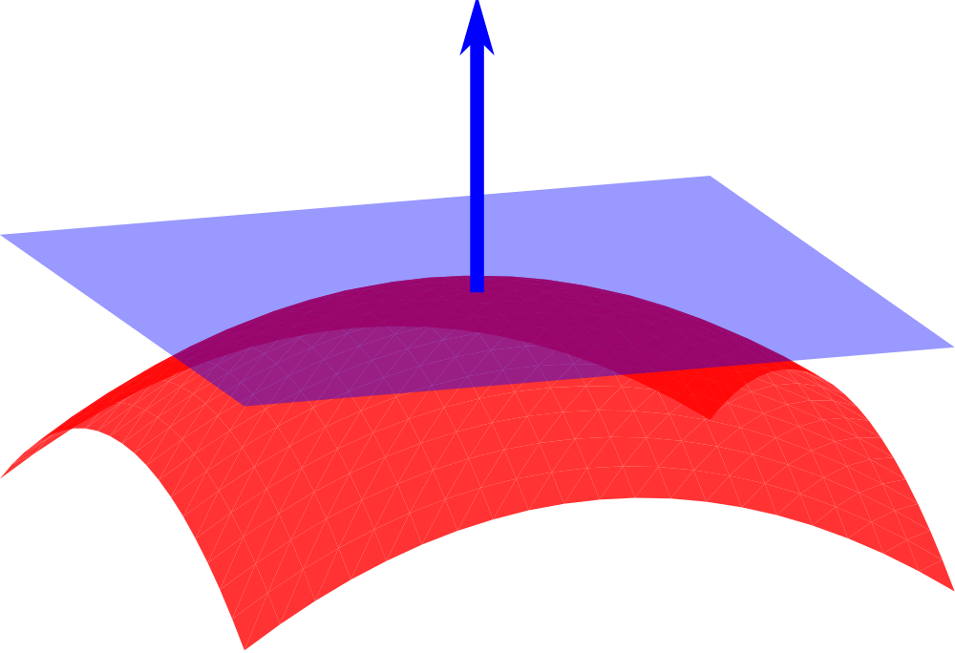
Tangent Planes and Normal Vectors
Tangent plane to a surface just ‘touches’ the surface at a point
The normal vector is perpendicular to the tangent plane

Slide 4
Unit Normal Vector
Normal vectors will usually be unit length
This makes calculations easier
We are especially interested in the angles between vectors
The process of transforming a vector to one in the same direction but of unit length is called normalization
Based on a different meaning of the word ‘normal’

Slide 5
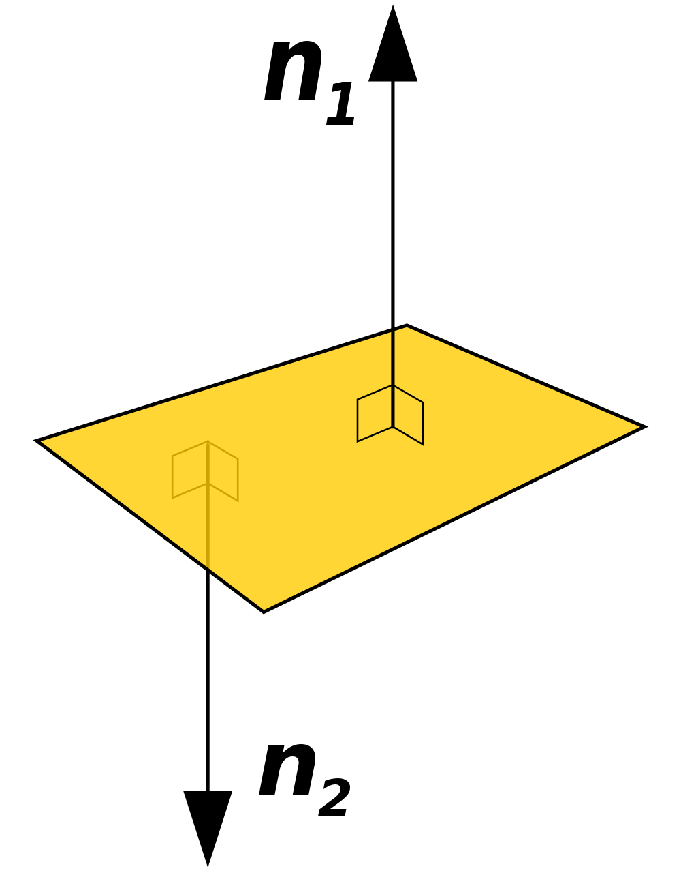
Normal Vectors in Two Directions
Normal vectors can point in two different directions from a surface
We will usually choose the normal to point to the outside of the surface of a solid

Slide 6
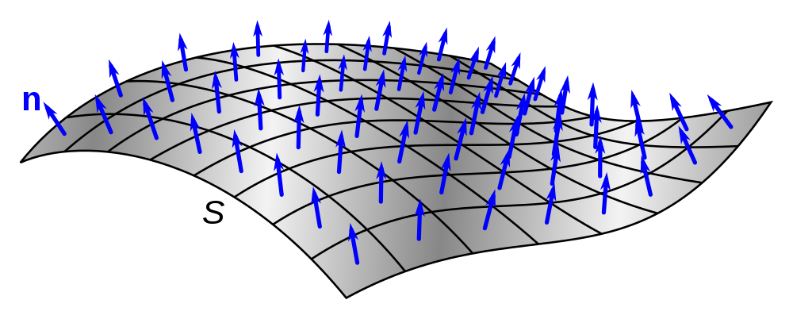
A Vector Field
Normal vectors at many points on a surface
Each ‘quad’ is approximately flat so the single vector will be a close approximation to the actual normal vector for the quad

Slide 7
Normal Vectors to Different Surfaces
Planes
Spheres
Parametric surfaces
Triangulated surfaces

Slide 8

Normal Vector to a Plane
A plane is flat, the normal vector is the same at all points on a plane
The same holds true for triangles
Plane equation $ax+by+cz=d$
Normal is the vector $\vec{(a,b,c)}$

Slide 9
Normal Vectors to a Sphere
The vector starting at the center of a sphere and extending to a point on the surface of the sphere is the normal vector to that point
Similar to drawing a radius from the center of a circle to a point on the circle

Slide 10

Parametric surfaces
Three functions of two variables define a parametric surface
$\left(x\left(u,v\right), y\left(u,v\right),z\left(u,v\right)\right)$
As the parameters $u$ and $v$ vary, the tuple $(x,y,z)$ traces out a surface
Derivatives of $x$, $y$, and $z$ with respect to $u$ and $v$ determine two vectors tangent to the surface at each point
Cross product gives the normal vector
Used this to get normal vectors for the shapes cylinder and torus in the library

Slide 11

Triangulated Surfaces
Quite often complex objects are given by a collection of triangles that approximate the surface
A normal to a triangle can be computed from its vertices $P$, $Q$, and $R$
Vector $Q−P$ crossed with vector $R−P$ yields a vector normal to the triangle
Vector $R−P$ crossed with vector $Q−P$ gives a vector pointing in the opposite direction

Slide 12

Order of Triangle Vertices
When listing triangle vertices, it is usual to order them so that the first normal vector computed on the last slide points outwards
Right hand rule
Wrap the fingers of your right hand around the outside of the triangle from $P$ to $Q$ to $R$ and your right thumb points in the direction of the first normal vector

Slide 13
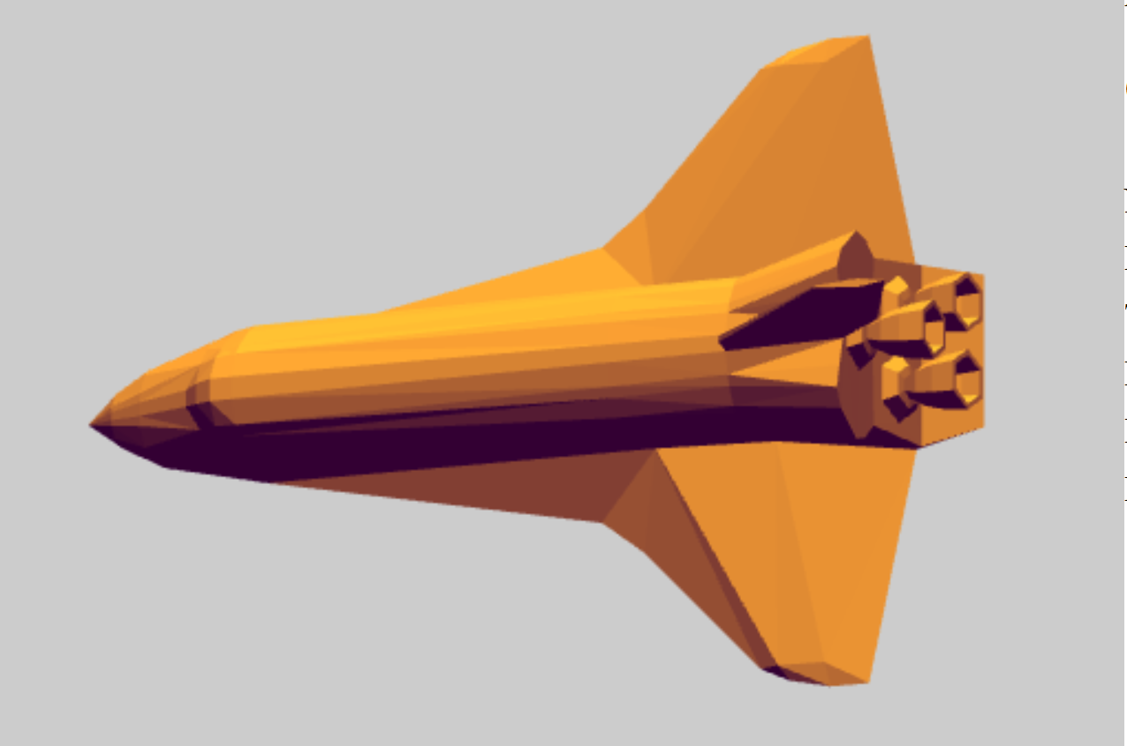
Triangle Normal Vectors
Using per-triangle normal emphasizes the corners and edges
This image is rendered from a shuttle model in WebGL

Slide 14
Averaging Normals
In a triangulated surface, the triangle normal vectors at each corner can be averaged to provide a normal vector to be used at that point

Slide 15
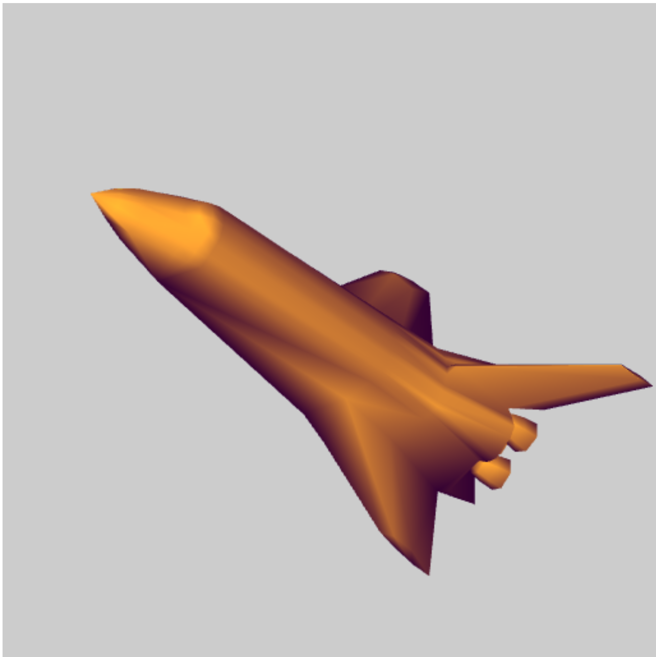
Averaged Normal Vectors
Averaging normal at corners where triangles meet smooths out the corners and edges

Slide 16
Transforming Normal Vectors
Normal vectors must be transformed when changing coordinates
However, the transformation matrix used for points will not work
The transpose of the inverse of that transformation matrix is used for normal vectors
A function for computing this is provided by GLM

